Slide 1
BANKRUPTCY CLASSIFICATION
MGMT 571 – Data Mining

Slide 2



TEAM – More to data!
SAI TEJA PASULA
Gopi Mashetty
Laksh Mudradi

Slide 3

ABOUT THE PROJECT
Firm collapse prediction has been a subject of interests for almost a century, and it still ranks high among hottest topics in economics. The aim of predicting financial distress is to develop a predictive model that combines various econometric measures and allows to foresee a financial condition of a firm. The purpose of the bankruptcy prediction is to assess the financial condition of a company and its future perspectives within the context of long-term operation on the market.

Slide 4





Modeling Process
5. Model Comparison
1. Data Sampling
Model Steps
4. Model Development
2. Data Exploration
3. Data Preparation

Slide 5
Data Sampling
Train Data – 10,000 Observations X 65 Columns
Target Variable : Class (1 = Bankrupted)
Predictors : Attr1 – Attr64
Test Data – 5,000 Observations X 65 Columns
Predictors : Attr1 – Attr64 & ID Variable
Sampling – Stratified sampling due to class imbalance
Training Data – 8500 Observations
Validation Data – 1500 Observations

Slide 6
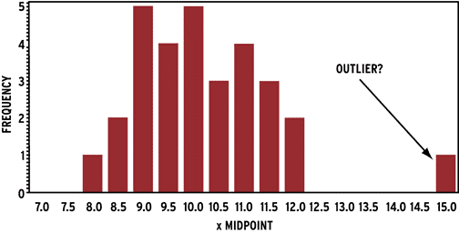
Univariate Analysis
Outlier Detection through Histograms
Bivariate Analysis
Variable Importance – Chi-Square
Correlation with Target Variable
Data EXPLORATION

Slide 7
Removing Duplicates
63 duplicate rows have been removed from the traning dataset
Outlier Treatment
Outliers have been replaced with µ-3σ and µ+3σ
Variable Transformations
Attr36 – Exponent of the variable
Attr21, Attr50, Attr61 – Inverse of the Variables
Data Filtering
Manual filltering of variables
Data PREPARATION

Slide 8



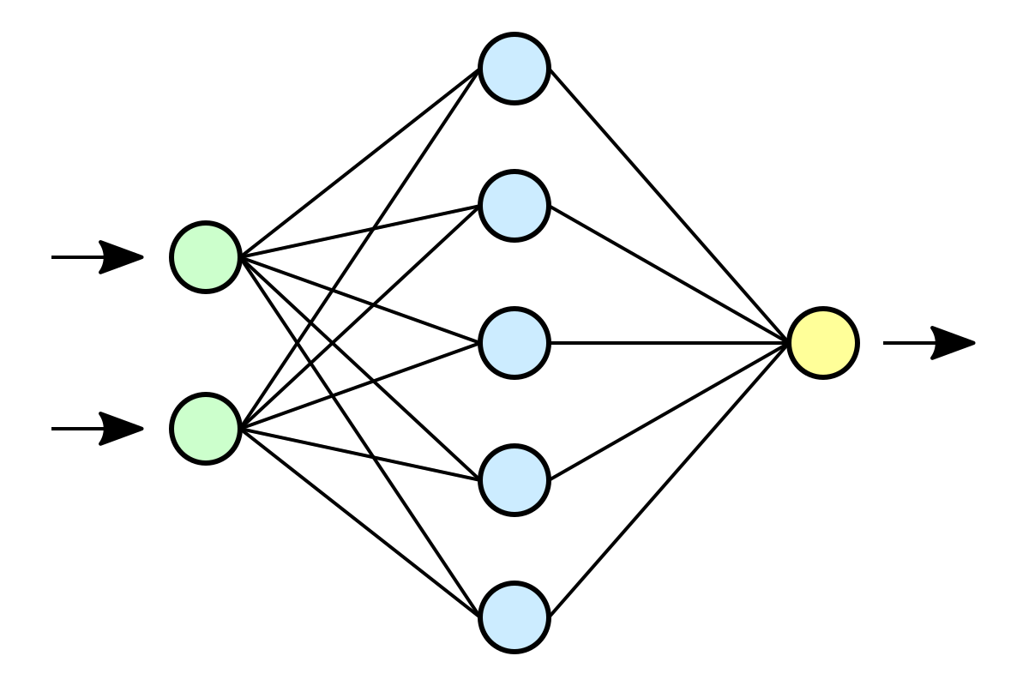
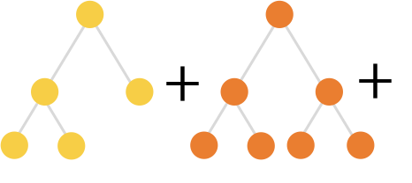
Logistic Regression
LASSO Regression
Classification Tree
MODEL DEVELOPMENT
Random Forest
Gradient Boosting
Neural Network

Slide 9

MODEL COMPARISON
GB is the best model with AUC = 0.928 on the private leader board
N Iterations = 500, Shrinkage = 0.05,
Train Proportion = 85, Huber M Regression = 0.6, Maximum Depth = 8, Reuse Variable = 8,
Interval Bins = 250, Leaf Fraction = 0.001,
Assessment Measure = Average Squared Error
Best Model Parameters

Slide 10
RECOMMENDATIONS
Firm’s Bankruptcy is highly sensitive to –
Ratio of Operating Expenses to Total Liabilities
Solvency Ratio
Ratio of Sales to Total Assets

Slide 11
LEARNINGS
Preliminary Data Cleaning Methods:
Outlier Treatment Methods
Machine Learning Techniques:
Regression, Tree based methods, Neural Networks
Model Assessment Measure:
R², Adjusted R², AIC, BIC, Accuracy, ROC, F1 Score
Regression Problem disguised as a Classification one

Slide 12
Thanks A LOT EVERYONE
Do you have any questions?

